Slide 1
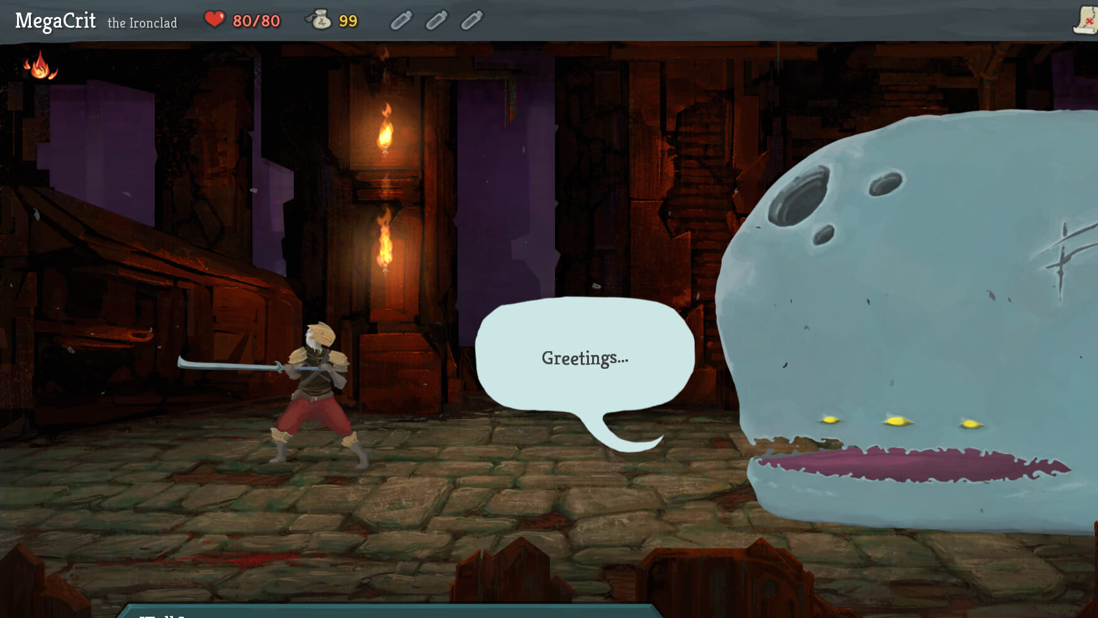
Slay the spire + GUI
Jonathan Sarasua

Slide 2
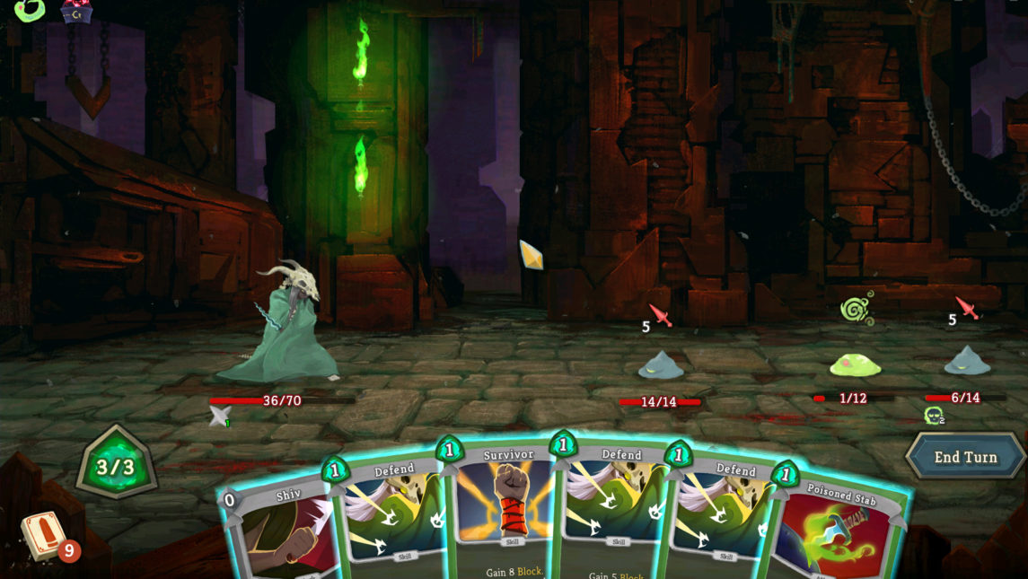
GUI system
Widgets
Widgets
Widgets
Widgets
Transform Hierarchy
States (Visible, Hidden, Pressed, Highlighted, Disabled, etc.)
Properties
Text, Text color, Background color, Image, and more
Cascading defaults
Transition states
XML based
Event System Integration

Slide 3
GUI system
Widgets
Widgets
Widgets
Widgets
Transform Hierarchy
States (Visible, Hidden, Pressed, Highlighted, Disabled, etc.)
Properties
Text, Text color, Background color, Image, and more
Cascading defaults
Transition states
XML based
Event System Integration

Slide 4
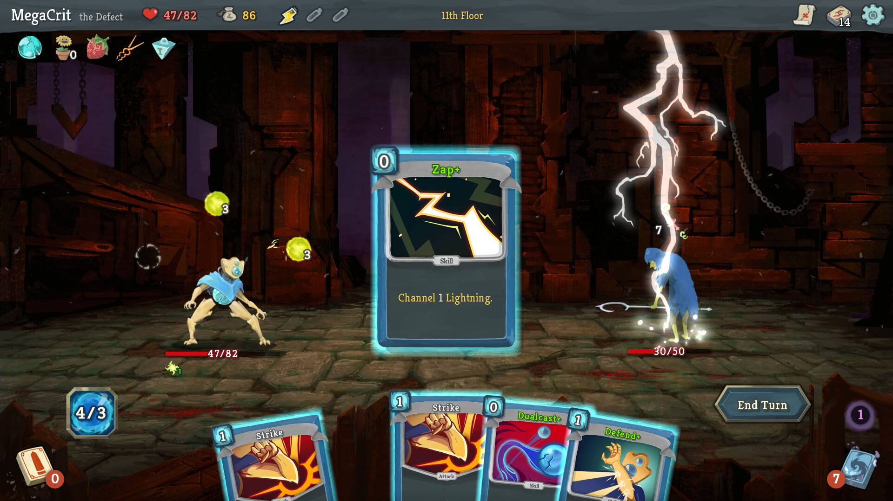
artifact
Mouse controls
Deckbuilding mechanics
Play cards, but have ways of gaining and removing cards
Slay The Spire-like rules and encounters

Slide 5
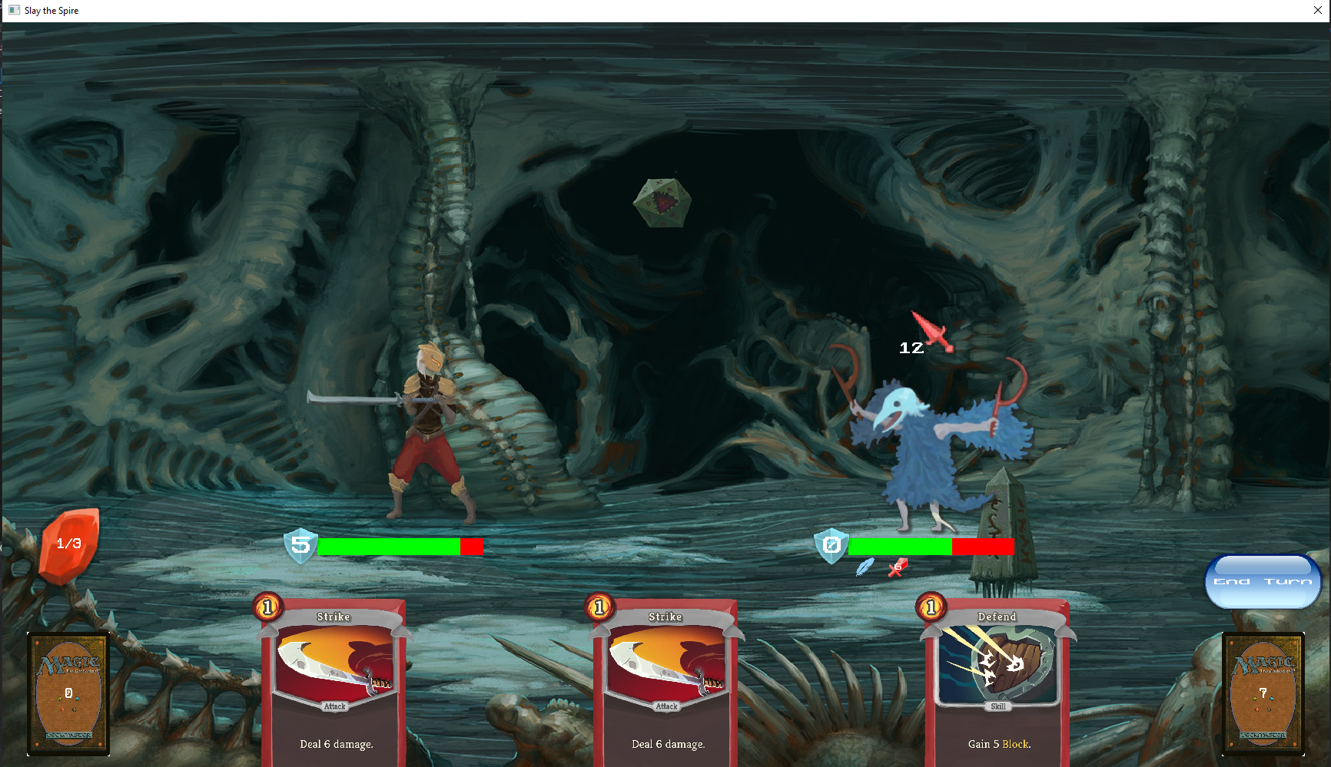
artifact
Mouse controls
Deckbuilding mechanics
Play cards, but have ways of gaining and removing cards
Slay The Spire-like rules and encounters

Slide 6
Intent (MoveTypeDefinition)
Player
Energy
Block
Health
Enemy (EnemyDefinition)
Card (CardDefinition)
Statuses (StatusDefinition)

Slide 7
Intent (Widget)
Player (Widget)
Energy (Widget)
Health (WidgetSlider)
Enemy (Widget)
Card (Widget)
Statuses (WidgetGrid)

Slide 8
Widget Construction
Set Transform
Scale = Dimensions
Position = Center of Widget relative to parent Widget
SetCanSelect( True )
SetEventToFire( “EventName” )
SetText( “End Turn” )
SetTextSize( 0.1f )
SetTexture( baseTex, hoverTex, selectTex )
ReleaseDelegate
Subscribe PlayCard

Slide 9
Lessons Learned
Watch use cases
AABB2 easier think about than Transform
Do you care about scale in the transform hierarchy?
Don’t be stubborn
Rewrite pain points

Slide 10
Plan Post Mortem
Original plan good
Estimates good
Game on schedule
Widgets mostly on schedule
Transitions and state still need to complete

